Slide 1
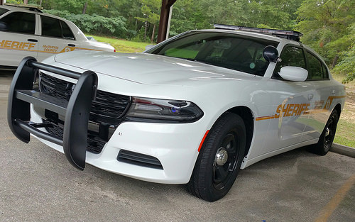
McDuffie County Sheriff’s Office
751 Public Safety Drive
Thomson, GA 30824

Slide 2
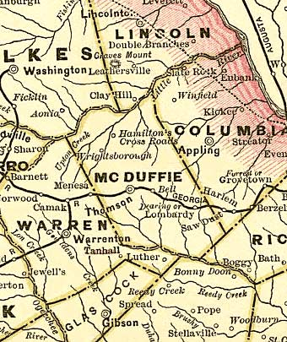
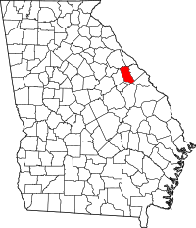
Where is McDuffie County exactly?
33.4563° N, 82.4817° W
McDuffie County borders Columbia, Richmond, Warren, Wilkes, Lincoln, and Jefferson Counties.

Slide 3
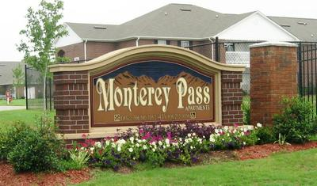
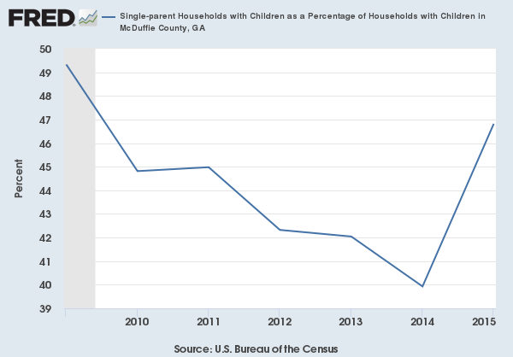
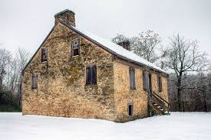
How big is McDuffie County?
Population: 21,231
Population Density: 81.7 per square mile
Water Area Percentage: 2.45% (6.52 square miles)
Land Area Percentage: 97.55% (259.77 square miles)
Total Area: 266.30 square miles
Housing Units: 8,916 per square mile

Slide 4
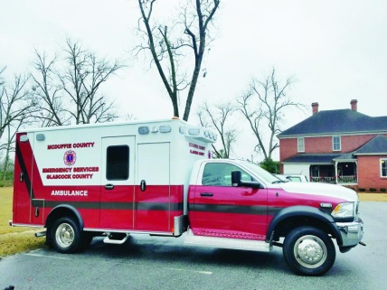
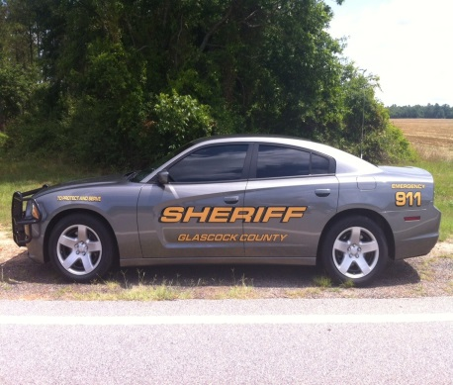
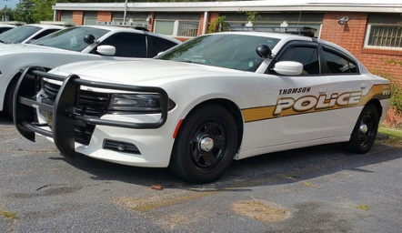
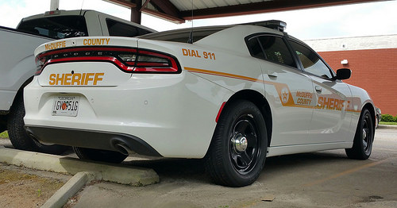
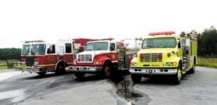
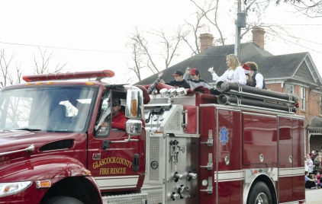
Communications
Who does the McDuffie County Communications Officers dispatch for?
McDuffie County Sheriff’s Office
McDuffie EMS and Fire
Thomson Police Department
Glascock Sheriff’s Office
Glascock EMS and Fire Rescue

Slide 5
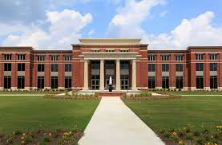
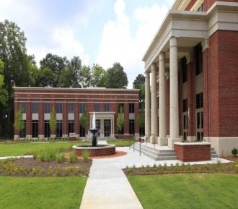
What can MCSO do for you?
Working for McDuffie County Sheriff’s Office you have the means to do more than just work for a larger department.
For example: our deputies come to work and begin their shift by patrolling their assigned zones, serving civil papers or warrants, conducting traffic patrols, answering dispatched calls and making arrests. You get the liberty of working the full case from start to finish.
When you make an arrest the suspect is innocent until proven guilty by a court of law. The process as you may know is a very lengthy process.
From the arrest you book them into the jail, then you get a court subpoena and you go to court. From there you state the case with the District Attorneys Office. The Judge or jury then hears the case, you testify and sometimes get cross examined then the Judge or jury makes a final ruling. Guilty or not Guilty.
With most larger departments, you make the arrest and then hand the case off to Criminal Investigation Division (CID). In McDuffie County you get training on how to do follow ups, investigate cases and you have the benefit of having an “On call” investigator at your disposal. So in essence you have more responsibly according to state law vs a police department.
The more experience you have, may lead to better job opportunity within any agency!

Slide 6
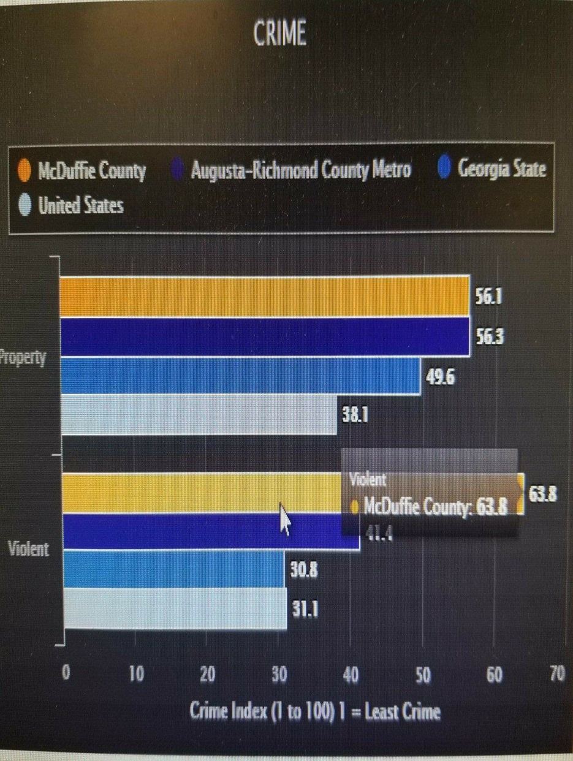
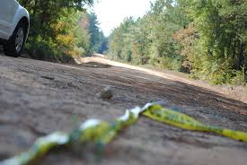
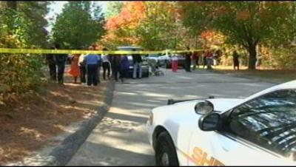
Crime Chart
McDuffie County, Georgia, violent crime, on a scale from 1 (low crime) to 100, is 64. Violent crime is composed of four offenses: murder and non-negligent manslaughter, forcible rape, robbery, and aggravated assault. The US average is 31.1.
McDuffie County, Georgia, property crime, on a scale from 1 (low) to 100, is 56. Property crime includes the offenses of burglary, larceny-theft, motor vehicle theft, and arson. The object of the theft-type offenses is the taking of money or property, but there is no force or threat of force against the victims. The US average is 38.1.

Slide 7
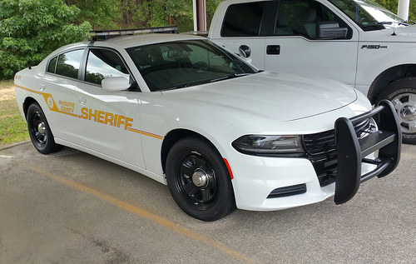
What's Important?
Standard base pay- $16.90 hourly /$33,800 yearly
Benefits – Blue Cross Blue Shield – Eye, Dental, Health and includes a pension plan. Health insurance is fully paid for by McDuffie County for the employee.
Equipment- County supplies all equipment and orders new equipment yearly.
Take home patrol unit within a certain radius from Sheriff’s Office.

Slide 8
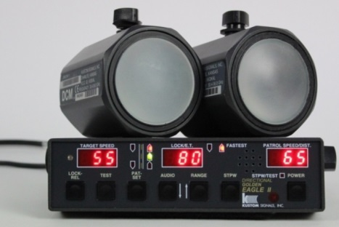
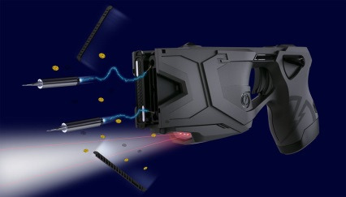
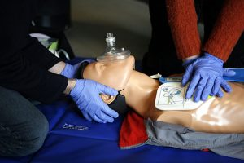
Employment
In house training such as: Taser Recertification, handgun, patrol rifle and backup yearly certifications, first aid and CPR, driving simulators, several various training programs for POST hours.
Shooting range that the agency upkeeps and owns.

Slide 9
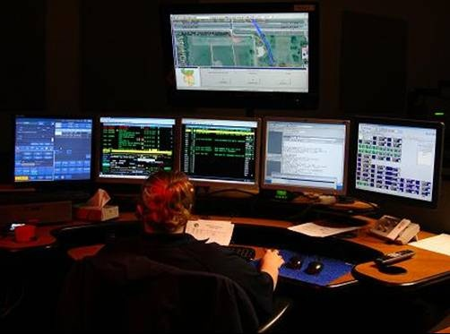
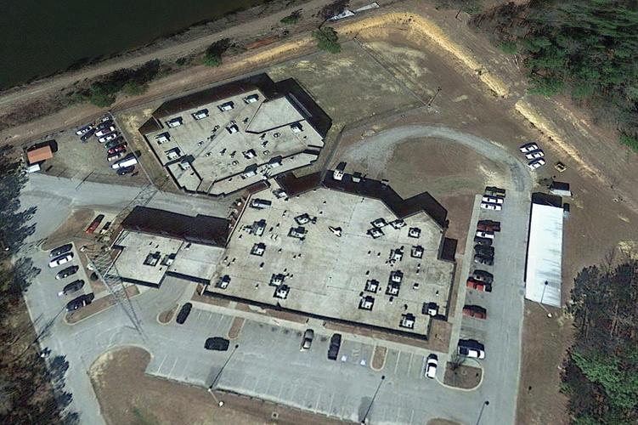
What all do we do?
Patrol Division
Traffic Division
C.I.D.
Court Bailiffs
Superior Court Security
Records Division
Jail Division
911Communications
Prisoner Transport

Slide 10
Do you have what it takes to work for McDuffie County Sheriff’s Office?
Sheriff: Logan Marshall
Deputy Blake Murphy
Email: Blake.Murphy@thomson-mcduffie.net
706-504-7523
Chief Deputy: Ronnie Williamson
Email:
Ronnie.Williamson@thomson-mcduffie.net
Deputy Nathan Salyer
Email-Nathan.Salyer@thomson-mcduffie.net

